Slide 1

Introduction to electrical and electronics engineering
Peltier Based ThermoElectric Coolers
Using PWM Controllers
GROUP-16
M.Thejeswara Reddy [ CB.SC.U4AIE24129]
V.NOOTHAN [ CB.SC.U4AIE24156]
1

Slide 2
Introduction
The project focuses on designing a Peltier-based thermoelectric cooling system controlled using PWM (Pulse Width Modulation).
It aims to provide an efficient and compact cooling solution using thermoelectric modules.
PWM control allows precise temperature regulation by varying the power supplied to the Peltier module.
The system can be integrated with microcontrollers and sensors for automatic temperature monitoring and control.
The project will also include an HTML and JavaScript-based interface for user interaction and real-time monitoring.
2

Slide 3
Problem Statement
Traditional cooling systems like compressor-based refrigerators are expensive, and consume high power.
Lack of precise temperature control in conventional cooling methods.
Inefficiency in energy usage due to constant power supply instead of adaptive regulation.
Difficulty in cooling small, specific areas where traditional cooling methods are impractical.
Overheating issues in electronics and small devices requiring efficient thermal management.
3

Slide 4
Advantages:
Disadvantages:
Compact and Lightweight – Peltier modules are small and require less space compared to conventional cooling systems.
Low Efficiency – Peltier modules are less efficient than compressor-based cooling systems.
Long Lifespan – Due to the absence of mechanical components, these coolers have a longer operational life.
High Power Consumption – Requires a significant amount of electricity relative to its cooling capacity.
Temperature Control – The PWM controller allows fine control of cooling intensity.
Costly for Large Applications – More expensive per watt of cooling compared to traditional systems when scaled up.
4

Slide 5
Objective
To design and develop a thermoelectric cooling system using the Peltier effect.
To implement PWM control to regulate power consumption and enhance efficiency.
To achieve precise temperature control for various cooling applications.
To enhance heat dissipation techniques to improve the performance of the Peltier module.
5

Slide 6
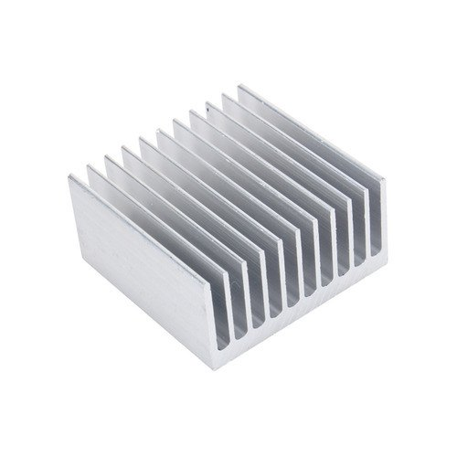
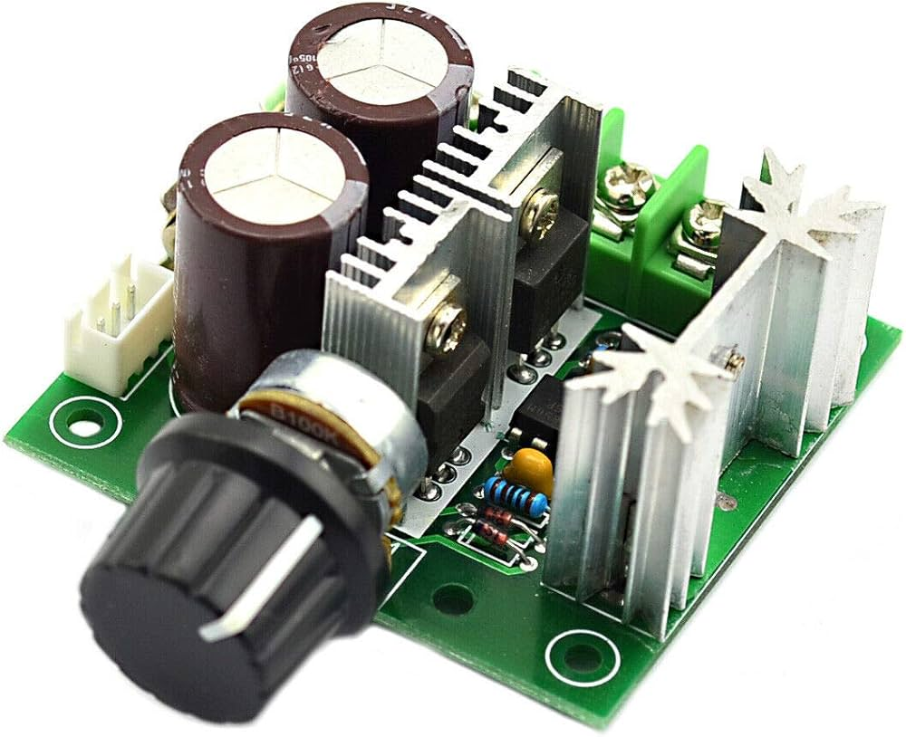
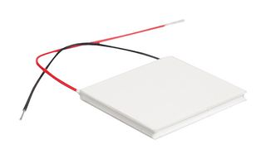
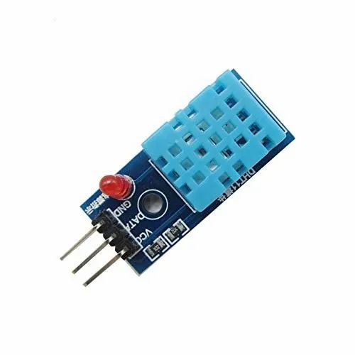
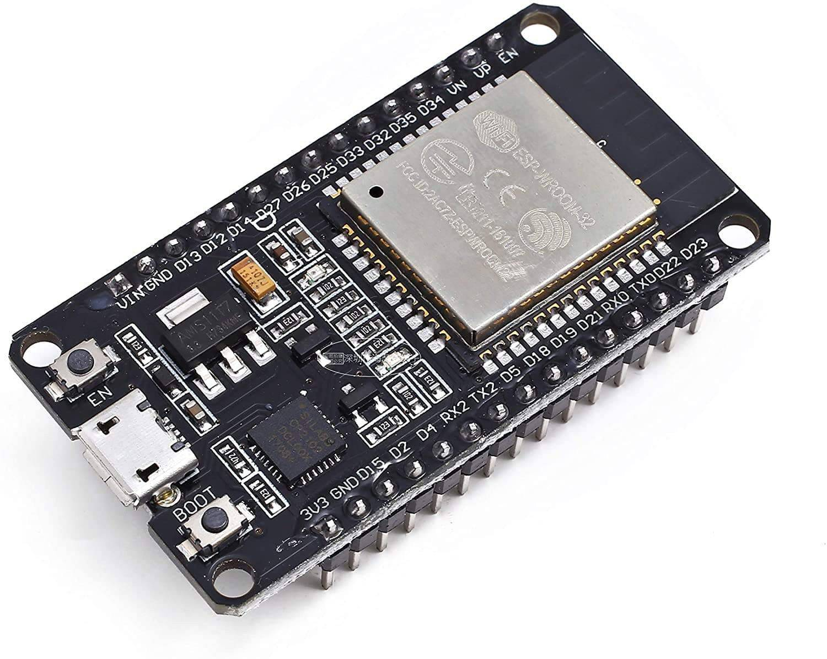
Block Diagram
Power Supply
Peltier module
Heat sink
PWM controller
(with a fan)
PWM signals
Data
DTH11 Sensor
6
IoT Kit ESP32

Slide 7
Methodology
Understand the working of the Peltier module and PWM control, then select the required components like
Peltier module, PWM controller, microcontroller (Arduino), heat sink, fan, temperature sensor, and power supply.
Connect the Peltier module with a heat sink and fan for heat dissipation. Integrate the PWM controller and microcontroller
to regulate power and connect a temperature sensor for monitoring.
Write and upload code to generate PWM signals, allowing dynamic power control based on temperature feedback for
efficient cooling.
Adjust PWM settings, optimize cooling performance, and ensure the system maintains stable temperature control under
different conditions.
7

Slide 8
Results and Discussion
Heat Dissipation Performance
Result: Measure the temperature on the hot side of the Peltier module with and without heat sinks/fans.
Inference: Proper heat dissipation is critical for maintaining cooling efficiency. Without adequate heat sinks or fans, the hot side temperature rises, reducing the Peltier module's effectiveness.
8

Slide 9

Conclusion and Future Scope
The implementation of a Peltier-based thermoelectric cooler using a PWM controller achieved precise temperature control and efficient energy consumption. Future work could focus on exploring advanced control algorithms, and integration with other technologies for broader applications.
9

Slide 10
References
https://www.labcenter.com/blog/sim-peltier-models/ used to read peltier module and its working principle.
https://control.com/technical-articles/understanding-the-basicsof-pulse-width-modulation-pwm/ used to read about PWM controller.
https://en.m.wikipedia.org/wiki/Thermoelectric_cooling used to read thermoelectric cooling effect.

